Slide 1

StockHub
Stock Market and Crypto Investment Platform

Slide 2
Abstract
Project Statement: This project aims to create a user-friendly web application providing comprehensive tools to help users manage their investment portfolios. It offers real-time market data, portfolio tracking, market analysis, and educational resources, making the investment process streamlined for both novice and experienced investors.
Outcomes:
Enable users to create and manage investment portfolios.
Provide real-time stock market and crypto data for tracking performance.
Facilitate informed investment decisions with market analysis tools.
Enhance engagement with educational resources and news.
Deliver a seamless, intuitive user interface for market and portfolio management.

Slide 3
System Analysis
Why It’s Needed:
Accessibility: Limited access to easy-to-use, reliable market tools for beginner investors.
Data Complexity: Investors often struggle to track and analyze vast amounts of market data efficiently.
Educational Gap: Many platforms focus on experienced investors, leaving beginners without guidance or resources.
Problems Faced:
Real-time Data Integration: Managing data delays and ensuring live updates.
Efficient Data Storage: Handling high volumes of market data efficiently in MySQL.
User Retention: Attracting and retaining users through engaging features and reliable services.

Slide 4
Drawbacks of Current Systems
Complexity for Beginners: Advanced market platforms often overwhelm new investors with jargon and complex interfaces.
High Costs: Many platforms charge fees, making it difficult for budget-conscious users to participate.
Lack of Educational Tools: Few platforms focus on educating users on basic to advanced investment strategies.
Limited Customization: Users are often unable to personalize the platform based on their unique investment needs.

Slide 5
Proposed System
Features:
User-friendly design catering to both new and experienced investors.
Secure authentication with login and registration.
Real-time data integration and portfolio tracking.
Enabled payment gateway services for investment
Advantages:
Accessible: Focused on user ease of use, especially for beginners.
Cost-effective: Affordable access to features typically behind paywalls.
Personalized: Dashboard and portfolio systems for a tailored experience.

Slide 6
System Requirements
Software Requirements:
Frontend: React Js(for UI), CSS, HTML, JavaScript.
Backend: Spring Boot, Java
Database: MySQL
Hardware Requirements:
Development machine with at least 4 GB RAM, Core i5 or Ryzen 3 processor, and 20 GB of free storage.

Slide 7
Modules Description
1. User Authentication and Registration:
Features: User sign-up, login
2. Portfolio Management Interface:
Users can create and manage their portfolios with stock holdings, profit/loss calculations, and performance analysis.
3. Stock Market Data and Visualization:
Real-time data retrieval and visualization of stock performance with interactive charts.
4. Budget Management:
Track budgets and expenses for investments, including portfolio allocation.

Slide 8
Modules Description
5. Notification System:
(Future Scope): Allows users to set alerts based on market movements, price changes, and other customizable metrics.
6. Dashboard:
Central hub displaying real-time data and market page for displaying trends in a concise format.
7. Payment Gateway:
Implement a secure and reliable payment gateway (e.g., Razorpay, Stripe) to facilitate seamless transactions for adding funds, purchasing stocks, and withdrawing earnings.

Slide 9
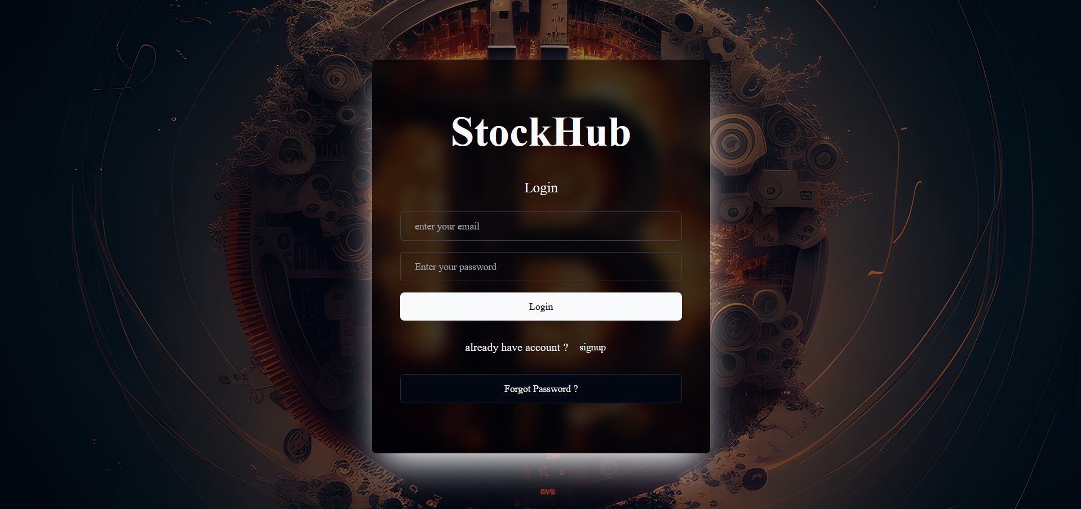
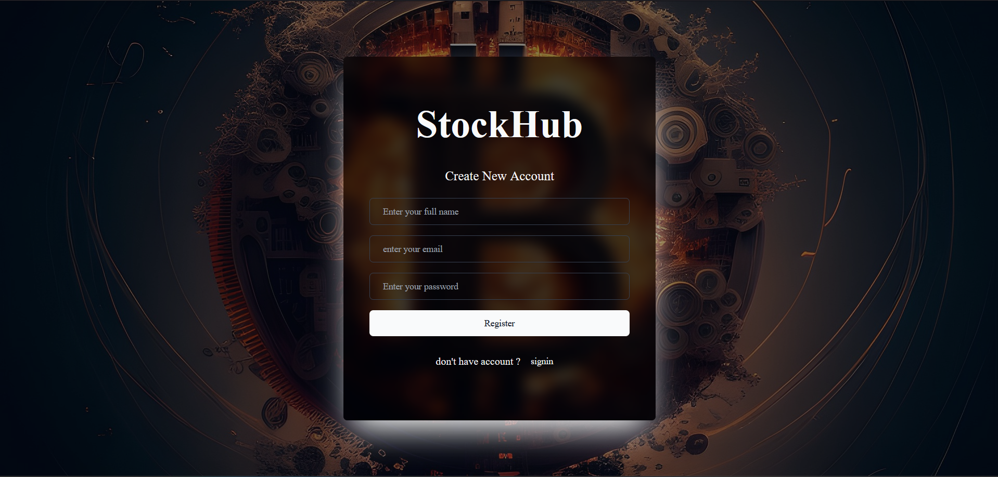
Login Page Signup Page

Slide 10
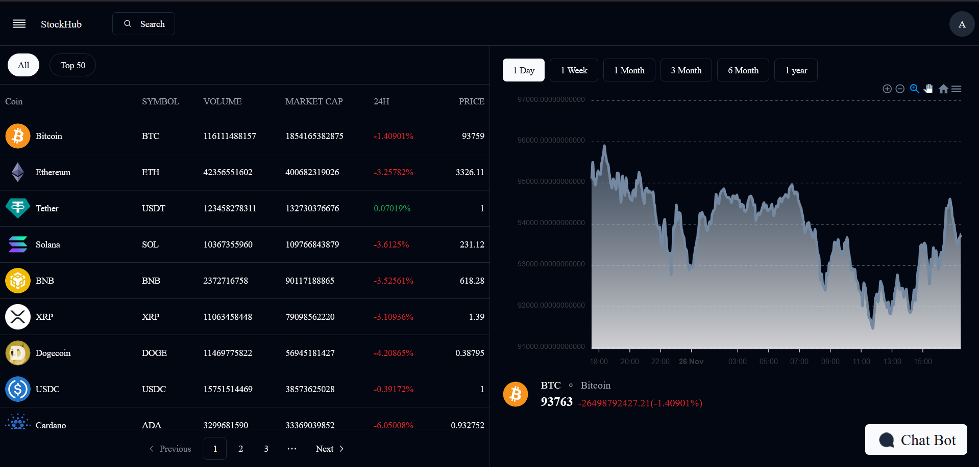
Dashboard Page

Slide 11
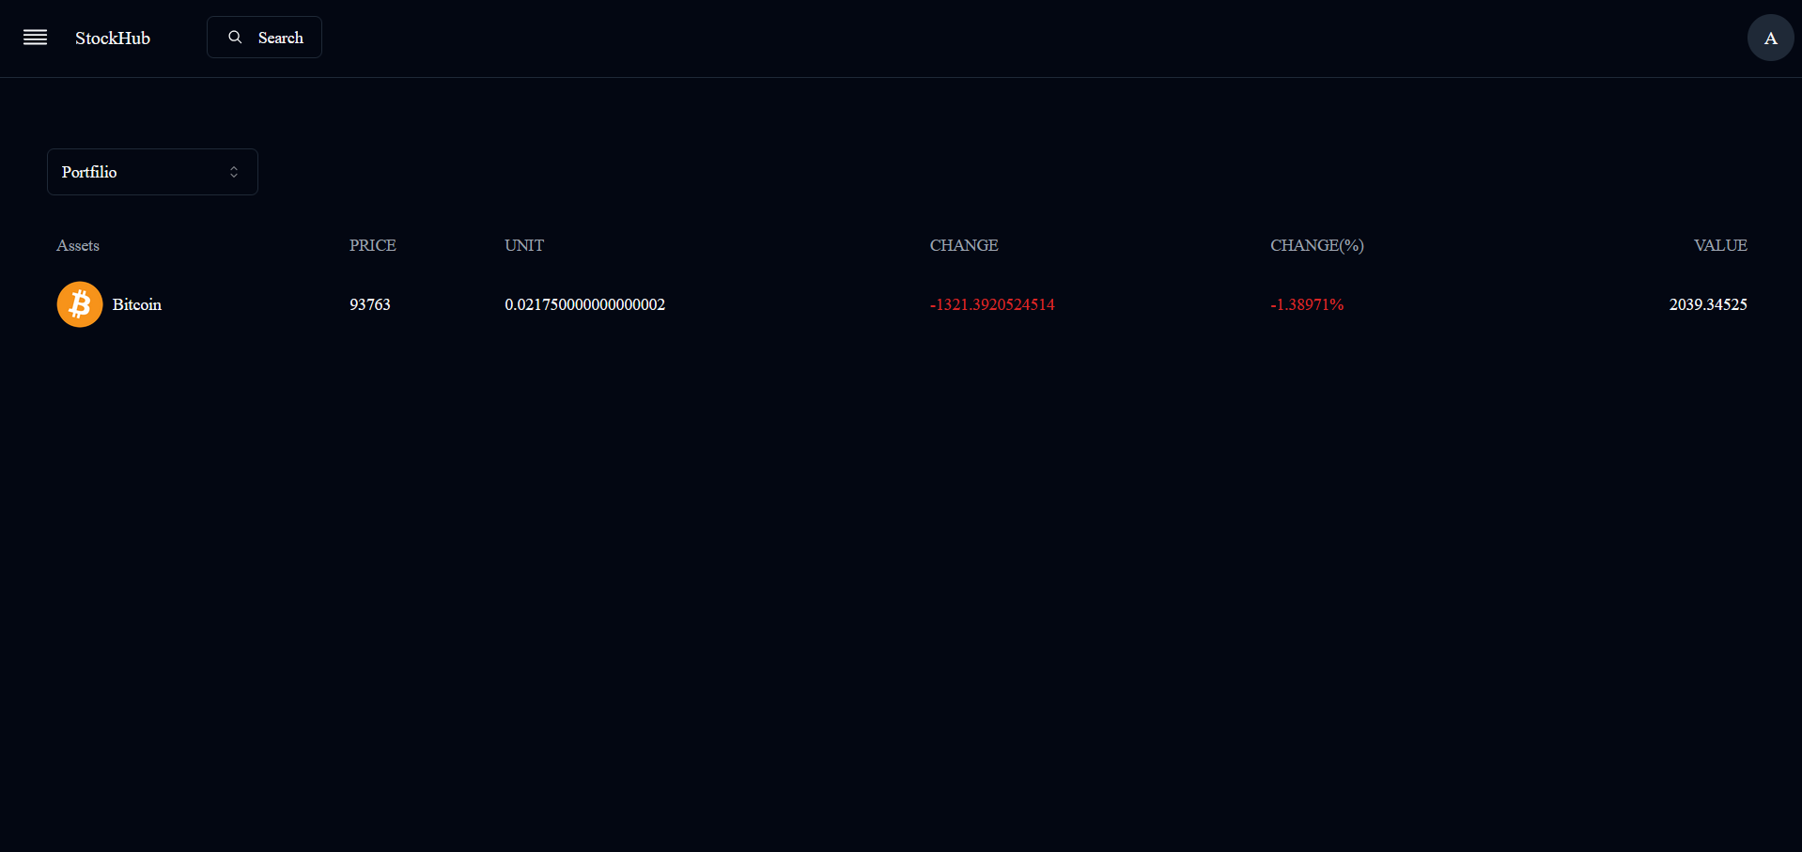
Portfolio Page

Slide 12
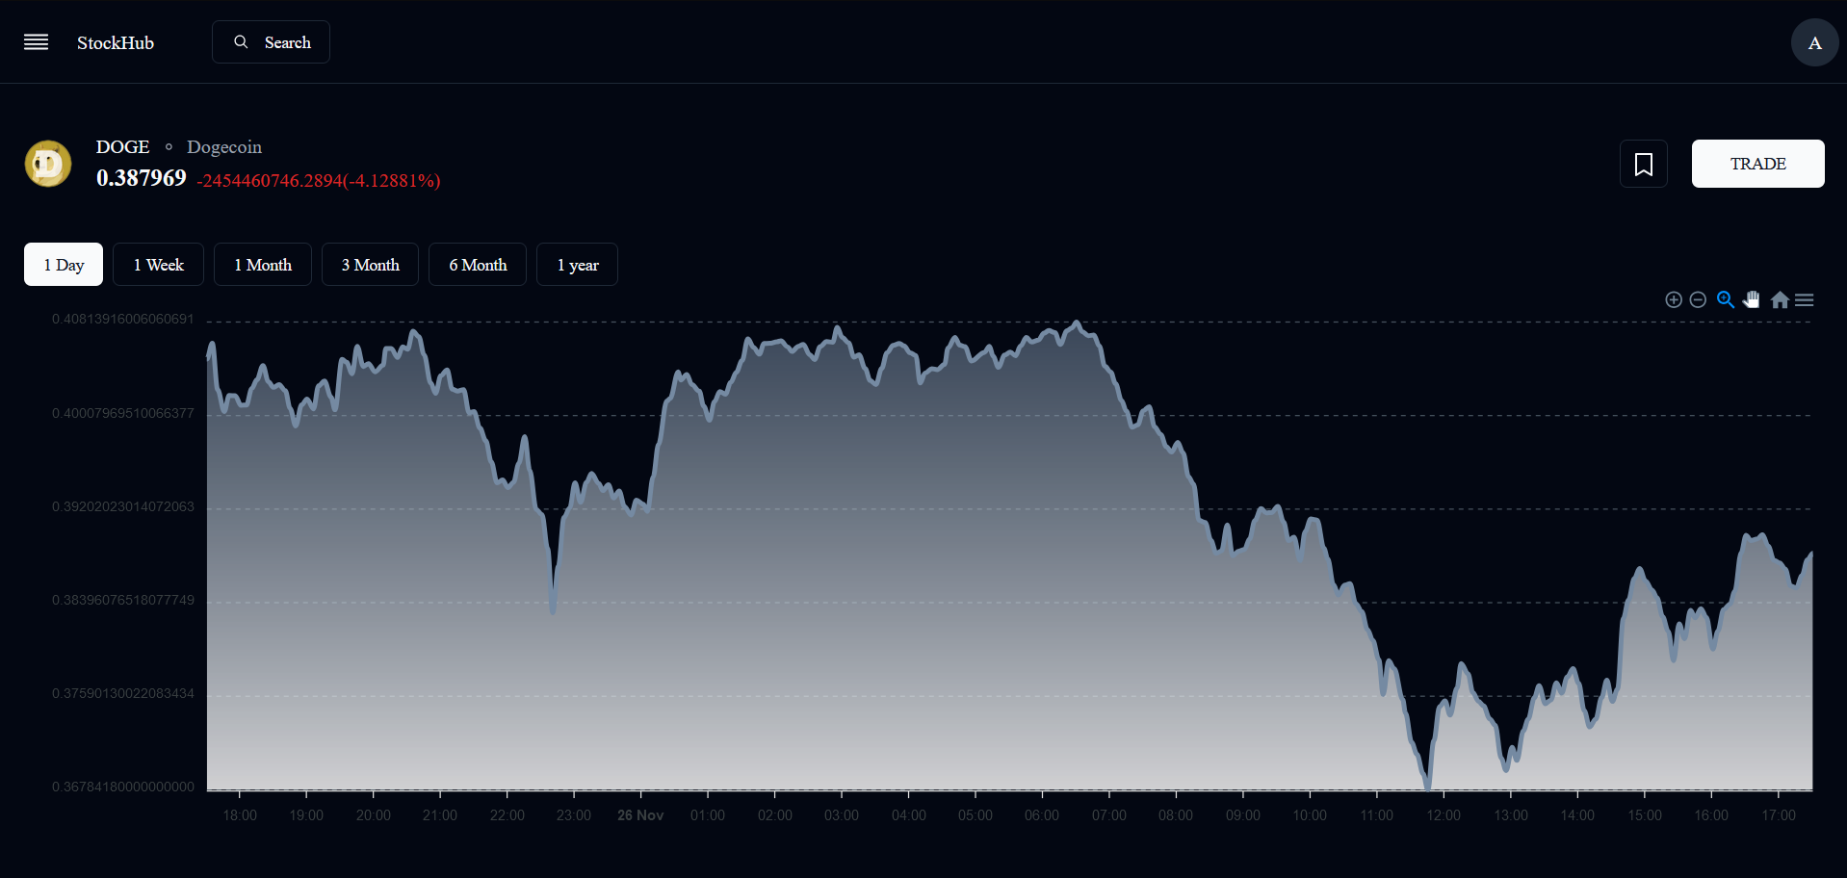
Market Page

Slide 13
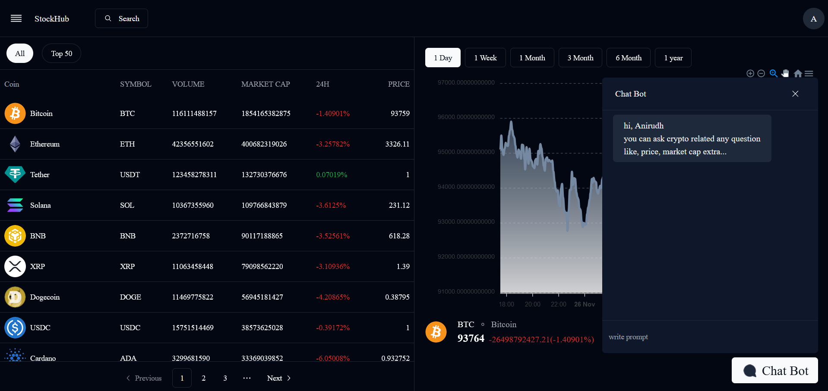
Chat Page

Slide 14
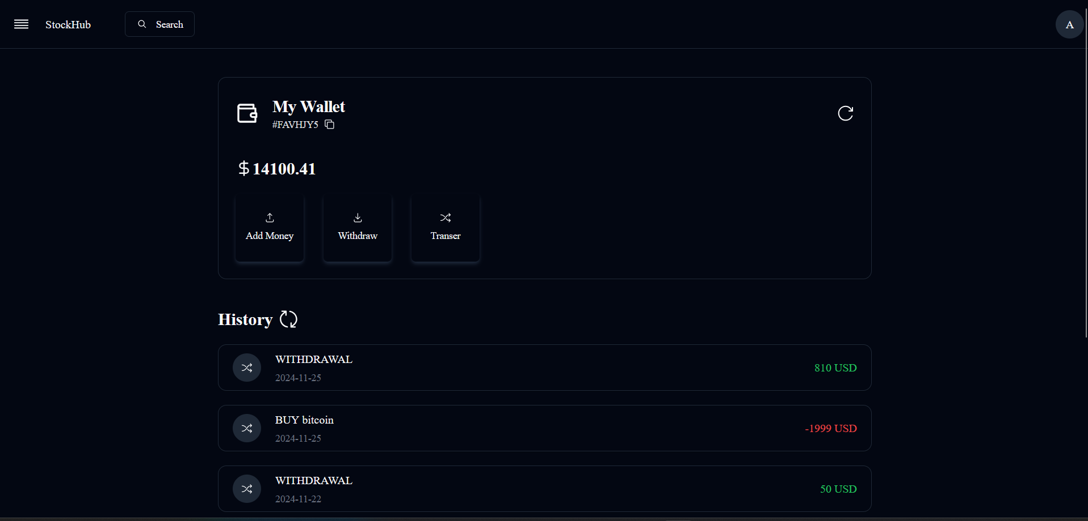
Wallet Page

Slide 15
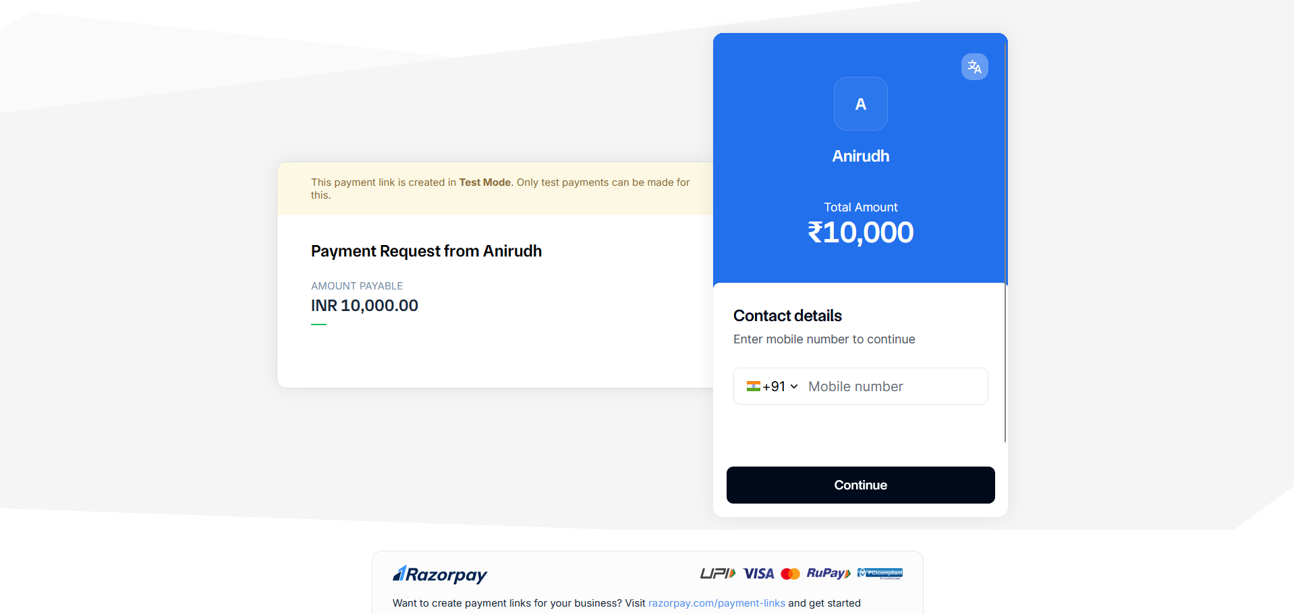
Payment Gateway

Slide 16
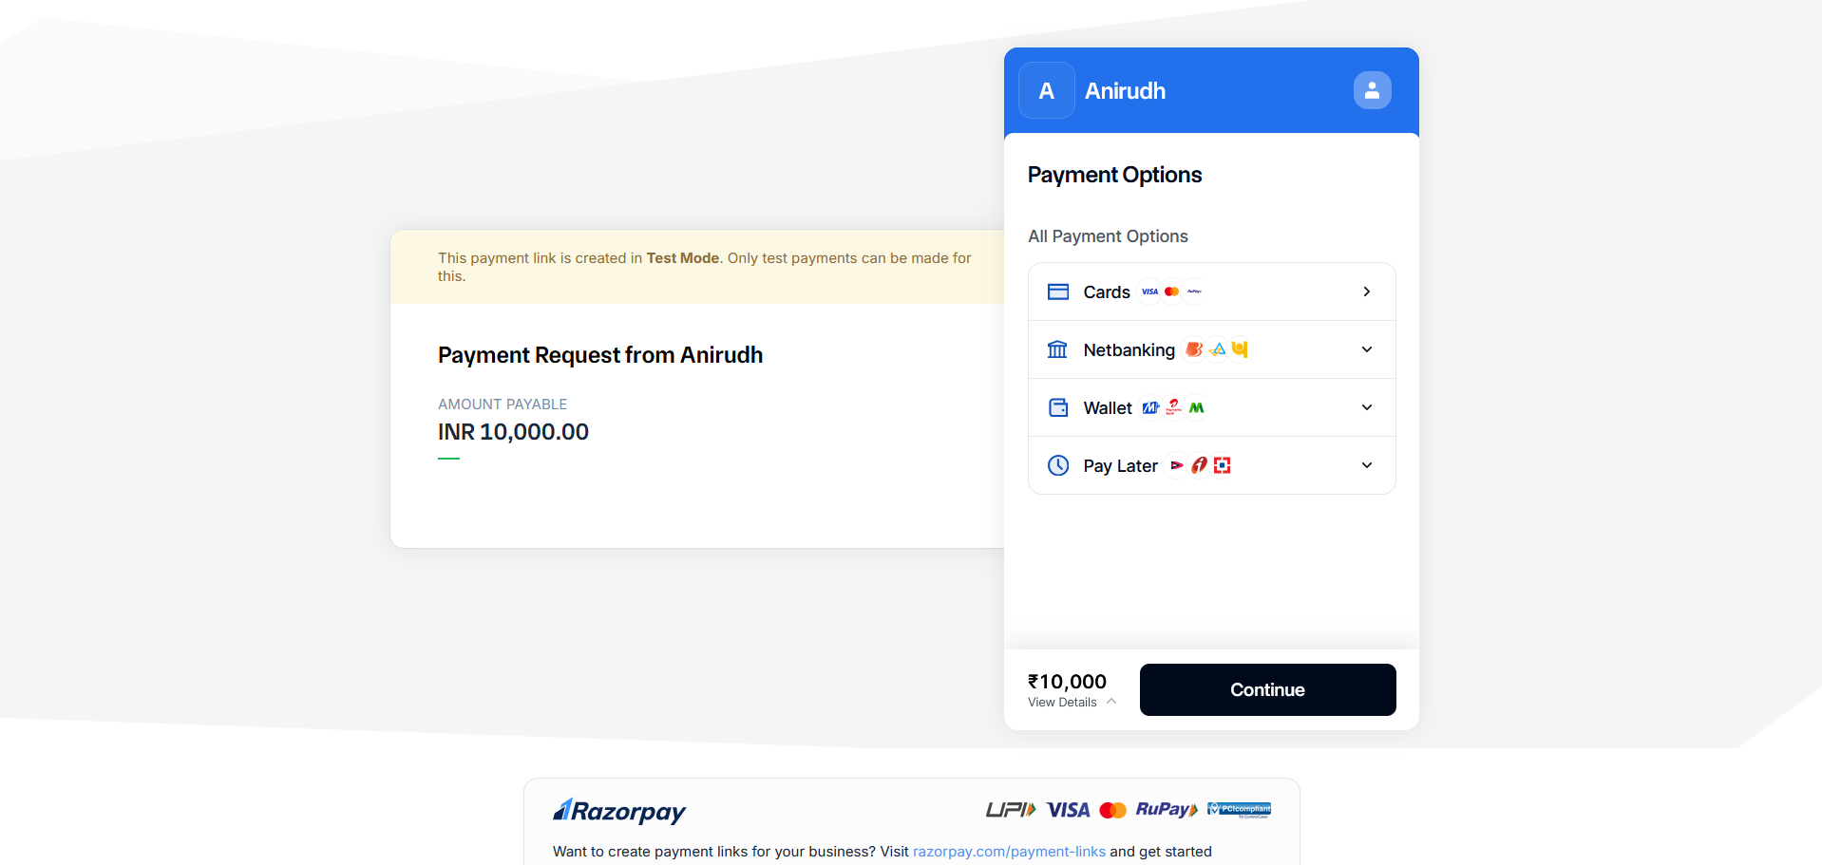
Payment Gateway

Slide 17
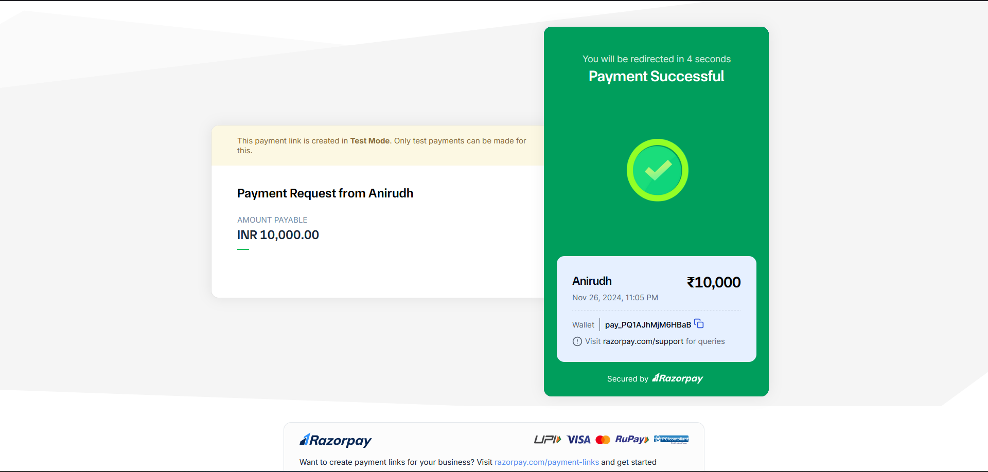
Payment Confirmation Page

Slide 18
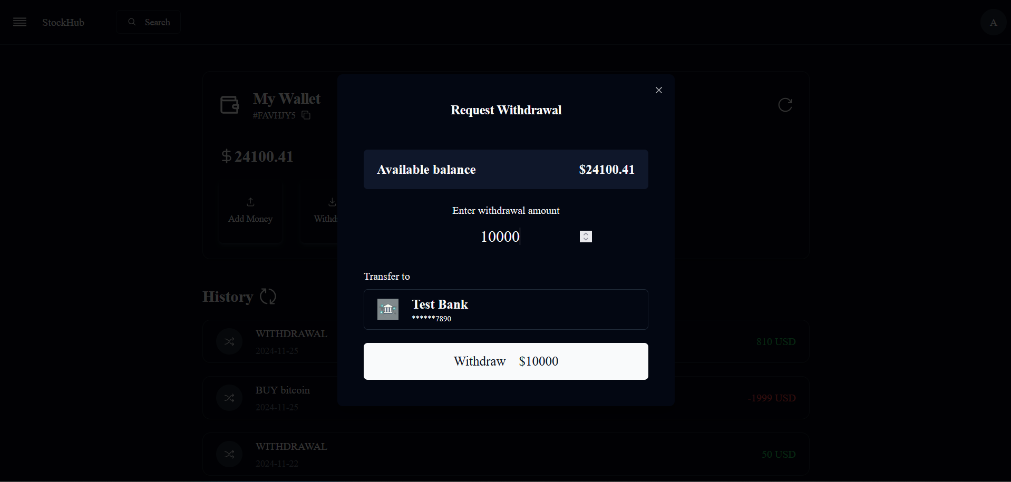
Withdrawal Page

Slide 19
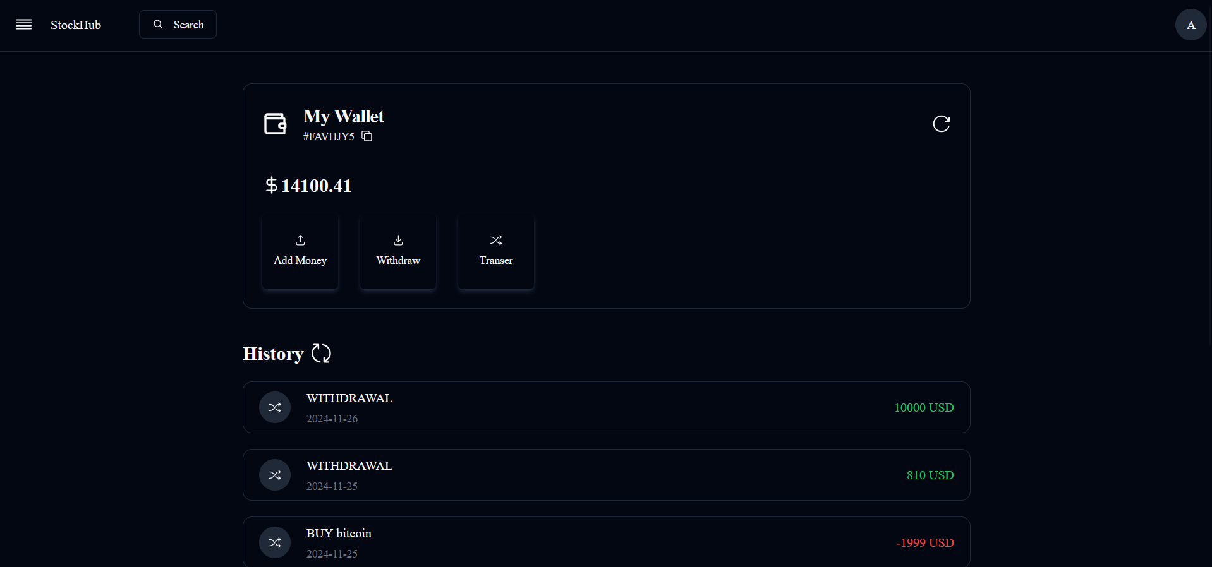
Updated Wallet

Slide 20
Conclusion
Summary: This Stock Market Investment Platform enables users to manage portfolios, analyze market trends with notification systems enabled for payments.
Future Enhancements: Adding predictive analytics, access to educational resources in a user-friendly interface and integration with more market data sources.

Slide 21
Thank You!!

